Slide 1
Video Game Market Analysis
MATEO MARIACA
SERGII LEBID
RATISH KUMAAR

Slide 2
Project Overview
The chosen dataset
Video Game Sales ( https://www.kaggle.com/datasets/gregorut/videogamesales )
Additional sources ( https://www.wikipedia.org )
The hypotheses
1) The sales of movie-based games are higher in the USA than in Japan
2)
3) The sales of video games are higher in North America than other countries

Slide 3
Data Acquisition, Enrichment, and Examination
Data Acquisition: Gathering relevant data from various sources.
1
Enrichment: Enhancing the collected data with additional information or context.
2
Examination: Analyzing and scrutinizing the enriched data to derive insights and draw conclusions
3

Slide 4
Database Design & Data Transformation
Provide a concise visualization or description of the Entity-Relational-Model
The key challenges faced during data transformation:
The necessity of using a non-standard delimiter when exporting from SQL to Tableau

Slide 5



SQL Insights & Advanced Analysis
Showcase one or two standout insights derived from advanced SQL queries.
Highlight any specific analyzes that were particularly challenging or revealing.

Slide 6
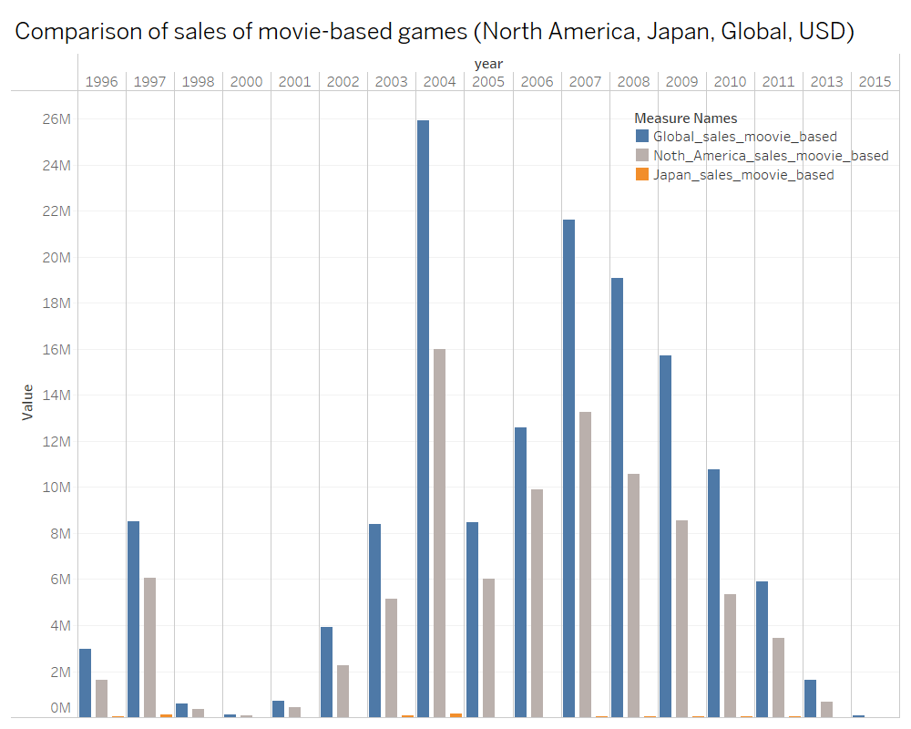
Visualization & Key Insights

Slide 7
Visualization & Key Insights

Slide 8

Thank you!

